Slide 1

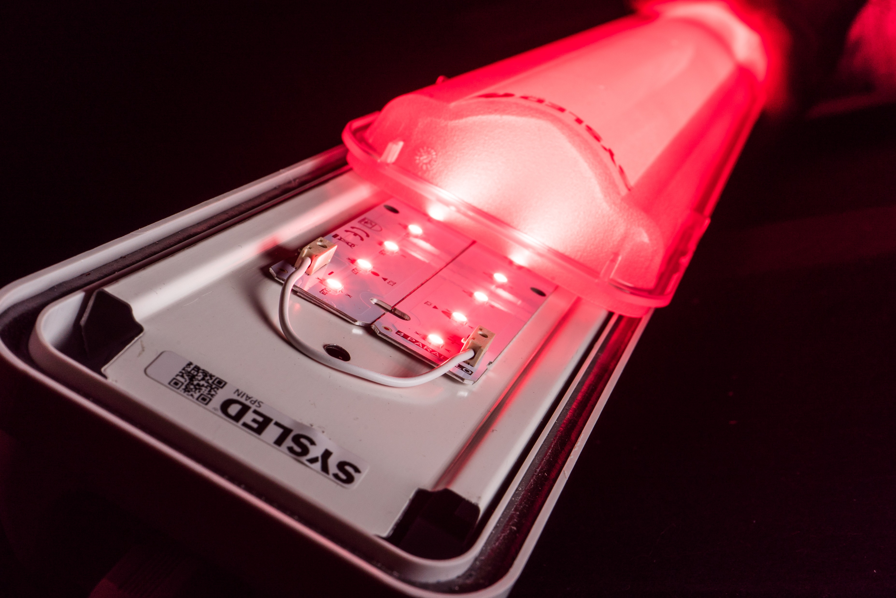
LED HORTICULTURE

Slide 2

INDEX
A NEW MARKET HAS BORN
LUMENS ARE FOR HUMANS
APPLIANCES AND PRODUCTS
EXPERIENCES
2 Pedro.cifuentes@sysled.es

Slide 3
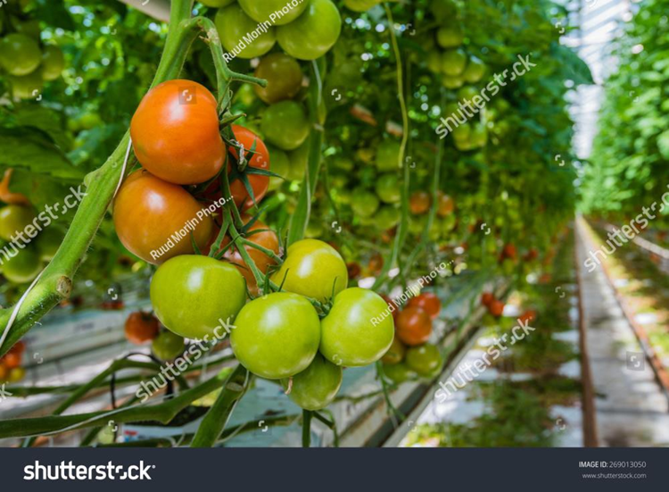
A NEW MARKET HAS BORN
ASTRONOMIC GROWTH: With an 83.3% Compound Annual Growth Rate (CAGR) LED horticulture market has become one of the most profitable markets (1)

Slide 4
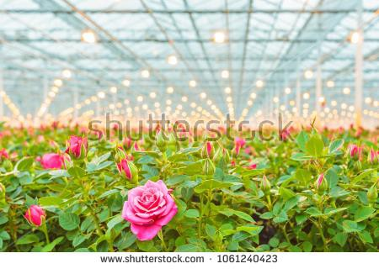
A NEW MARKET HAS BORN (II)
TOP GREENHOUSES VEG AREA IN EUROPE: agriculture represent a key market in Europe and LED represent the last frontier.
We control the temperature, humidity, irrigation, nutrients… except the
sunlight, with LED we dont rely on it anymore.
Country(2) | Acres | km2
Spain | 174 000 | 704
Italy | 62 000 | 250
France | 23 000 | 93
Hungary | 13 300 | 53
Poland | 12 889 | 52
Greece | 12 400 | 51
Netherlands | 12 022 | 51
(2) International Greenhouse Vegetable Production-Statistics 2015, Gary Hickman, Cuesta Roble Consultants

Slide 5
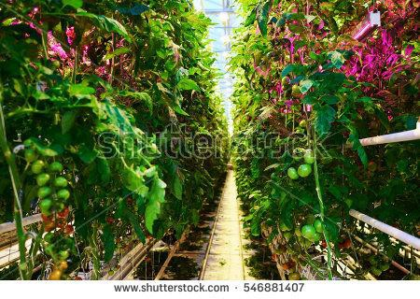
CASH CROPS: Main crops include tomato, cucumber, lettuce, strawberry, eggplats and medical cannabis. All of them are profitable markets very mature, they are open to new technologies to improve the yields
(3) Crop | $ per km2 | Crop | $ per km2
Medical Cannabis | 47 M | Tobacco | 277 K
Tomatoes | 1.42 M | Rice | 140 K
Grapes | 625 K | Strawberries | 107K
Potatoes | 365 K | Soybeans | 72 K
(3) Food and Agricultural Organization of the UN, VisualCapitalist, UNODC
5 Pedro.cifuentes@sysled.es

Slide 6
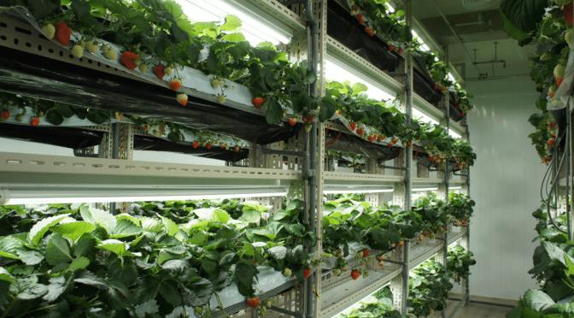
A NEW MARKET HAS BORN
TOMATO BASE BY COUNTRY: Industrial tomato growers harvest up to 60kgs/yr/plant. With LED, production can be push up to 27% of fresh product with a better taste(4)
(5) Country | Tons of fresh product
Turkey | 47 M
Spain | 1.42 M
Netherlands | 625 K
France | 365 K
Italy | 547 K
International Greenhouse Vegetable Production-Statistics, 2015, Gary Hickman, Cuesta Roble Consultants
Nighttime Supplemental LED Inter-lighting Improves Growth and Yield of Single-Truss Tomatoes, 2016, https://www.ncbi.nlm.nih.gov/pmc/articles/PMC4823311/
6 Pedro.cifuentes@sysled.es

Slide 7
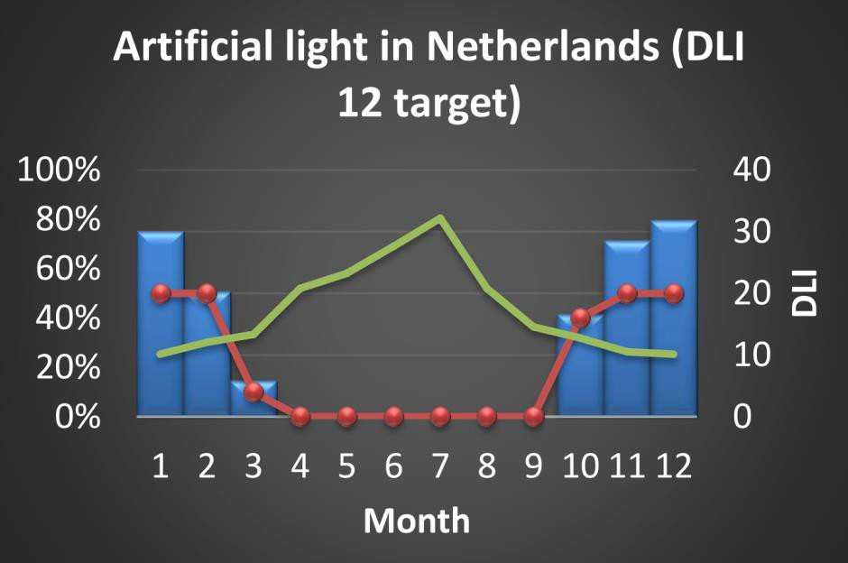
A NEW MARKET HAS BORN
2-3 billion € market in 2020
LED can be used as single light source or supplementary
Single light source is very common in medical cannabis, institutes and vertical farming
Greenhouse
Crop Science
Vertical farming
Medical plants
LED as supplement keep a steady light output along all the year, allowing growers keep a regular production workflow along the Winter seasons
Source: Valoya
7 Pedro.cifuentes@sysled.es

Slide 8

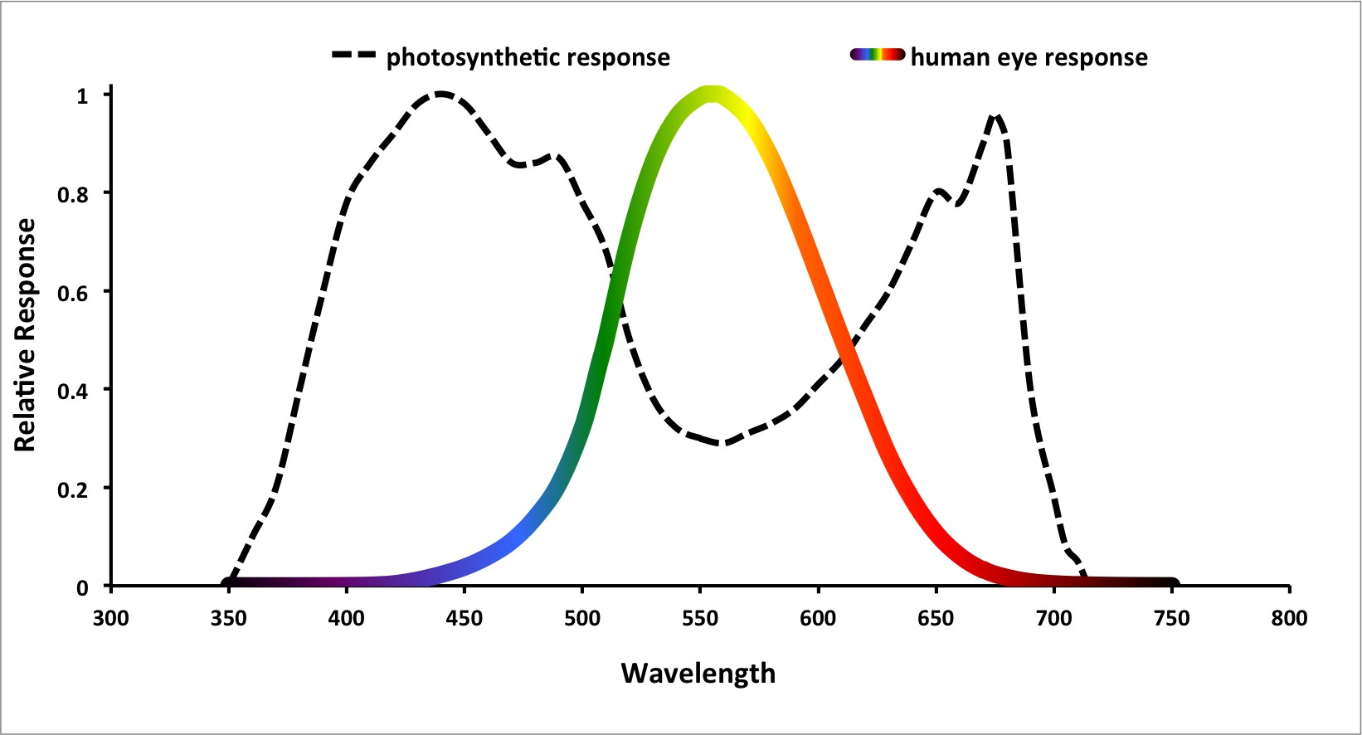

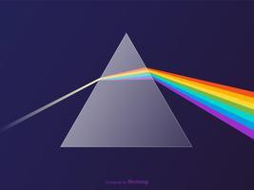
LUMENS ARE FOR HUMANS
We use the energy of the light for watching colors
plants use different colors for growth, this process is called
photosynthesis
Lumen
Is used by humans for illumination
PPF
Is used by plants for growth
PAR
Photosynthetic Active Region
8 Pedro.cifuentes@sysled.es

Slide 9
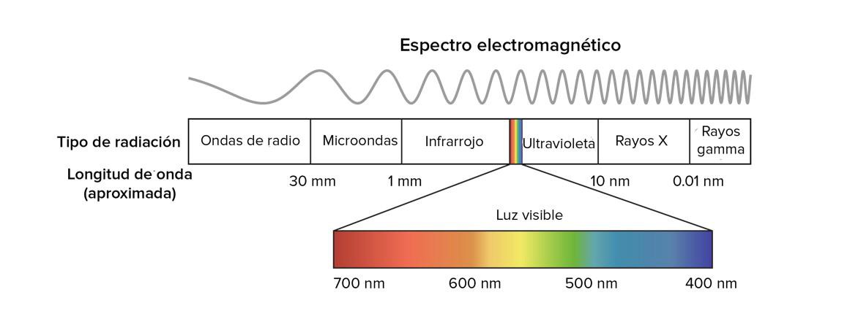
LUMENS ARE FOR HUMANS
We use the energy of the light for watching colors
plants use different colors for growth, this process is called
photosynthesis
Lumen
Is used by humans for illumination
PPF
Is used by plants for growth
PAR
Photosynthetic Active Region
9 Pedro.cifuentes@sysled.es

Slide 10
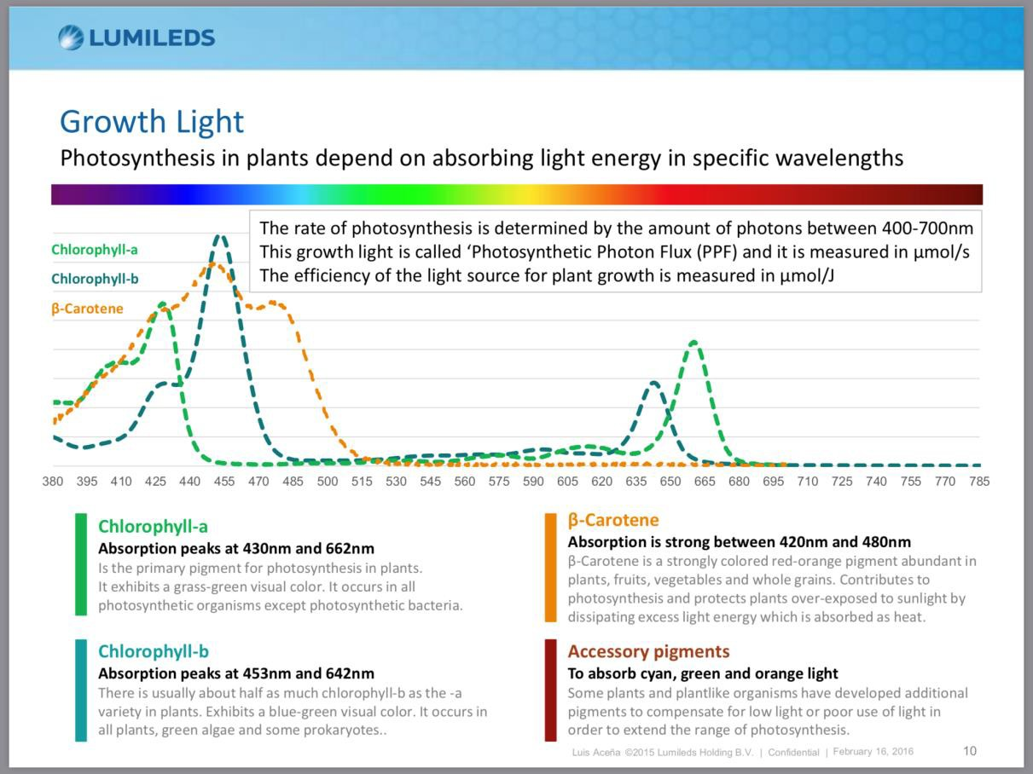
LUMENS ARE FOR HUMANS
PPF = Lumens
PPFD = Lux
PAR
10 Pedro.cifuentes@sysled.es

Slide 11
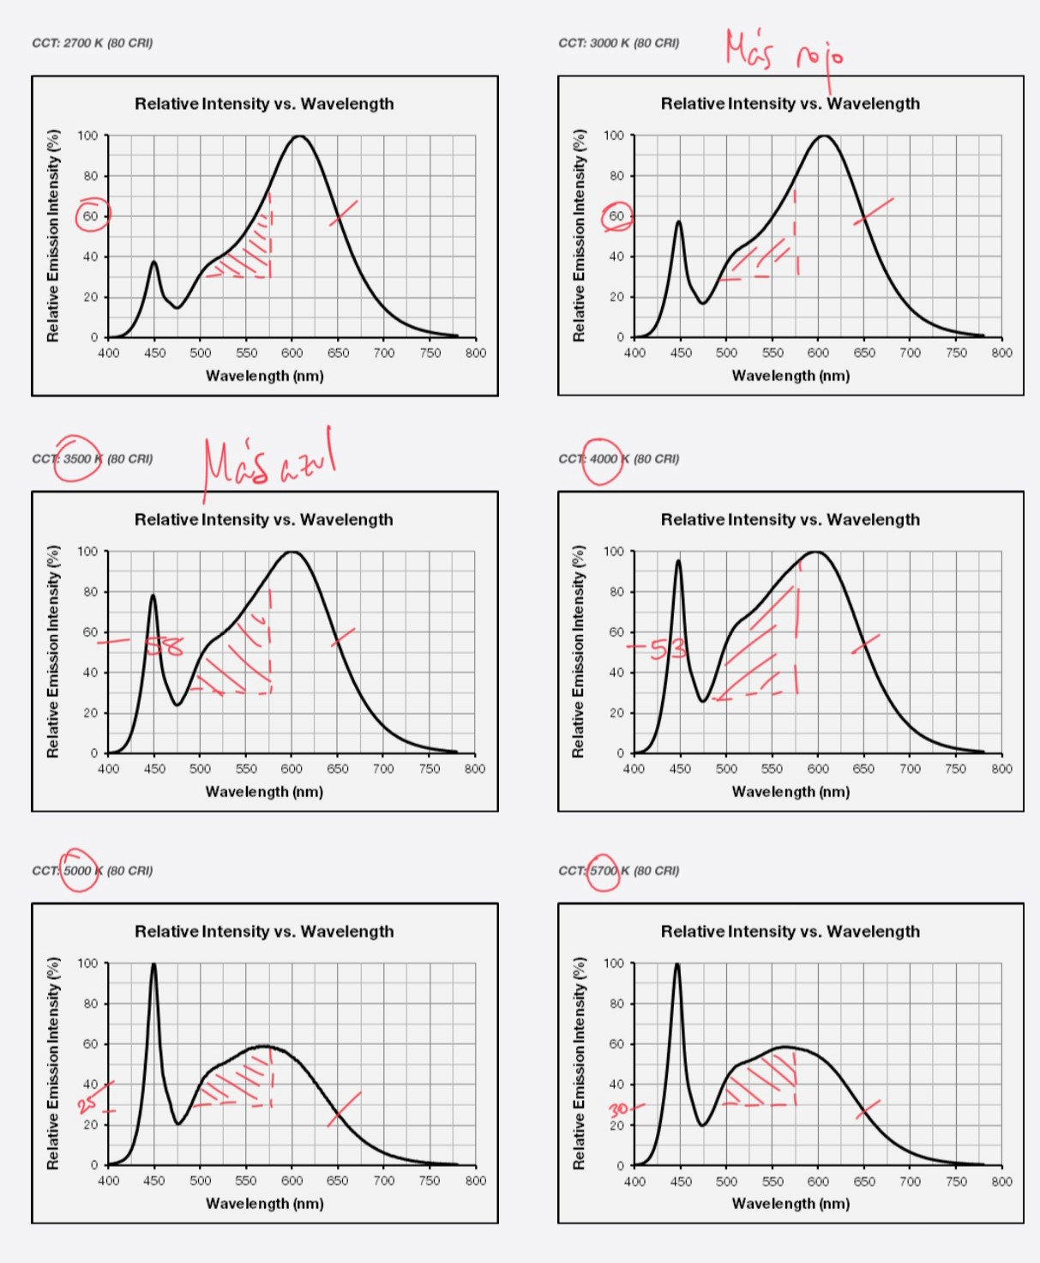
LUMENS ARE FOR HUMANS
PPF = Lumens
PPFD = Lux
PAR
SPD
11 Pedro.cifuentes@sysled.es

Slide 12
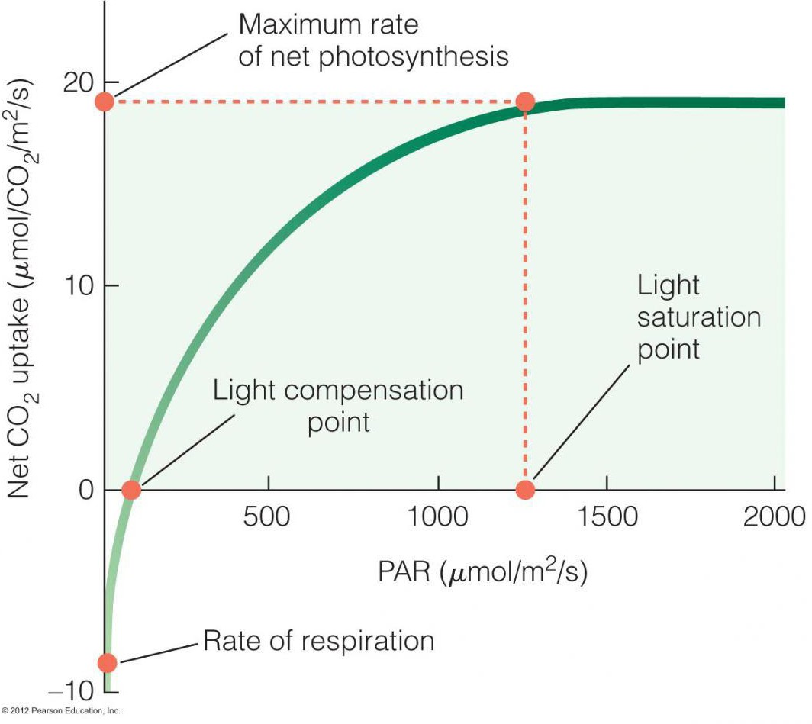
LUMENS ARE FOR HUMANS
PPF = Lumens
PPFD = Lux
PAR
SPD
DLI
12 Pedro.cifuentes@sysled.es

Slide 13
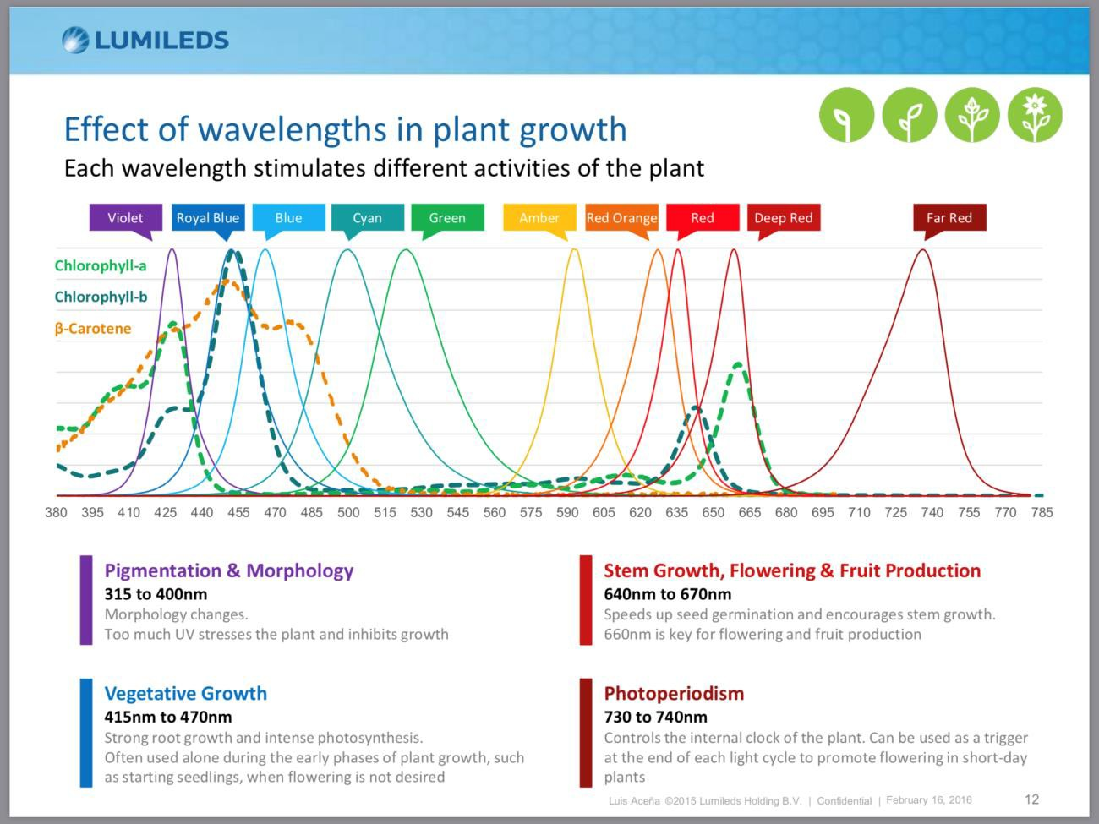
LUMENS ARE FOR HUMANS… so easy?
PPF = Lumens
PPFD = Lux
PAR
SPD
DLI

Slide 14
PPF FOR PLANTS
Is all about PPF?
PPF is the quantitative measurement
Ratios
Represent the qualitative measurement
The diet of a baby is different from eldery
40% Proteins + 40% Carbs + 20%Fats = %UV + %RB + %DR + %FR
FIND THE BEST RATIO FOR YOUR CROPS
14 Pedro.cifuentes@sysled.es

Slide 15
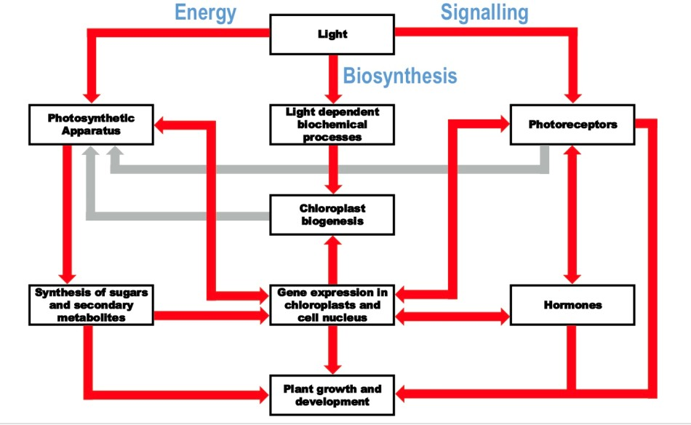
PPF FOR PLANTS – FAR AWAY FROM PHOTOSYNTHESIS
Signals cascade
Promote/block
different biochemical
behaviors UVA
365-400nm:
promote resin
generation
Royal Blue
400-500nm:
promote rooting
Far Red >700nm:
promote
internodal distance

Slide 16
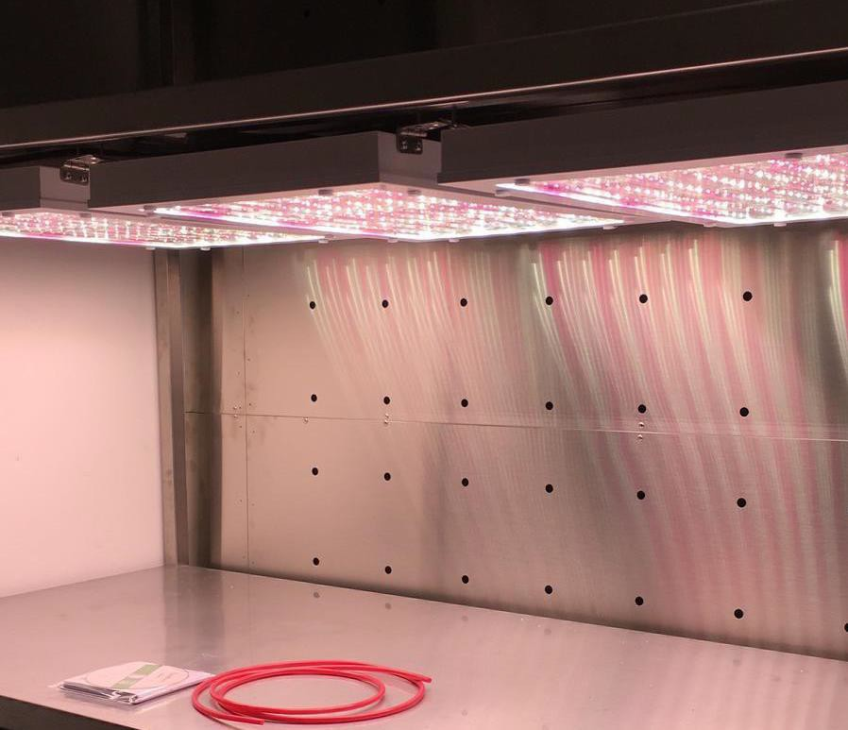

Slide 17
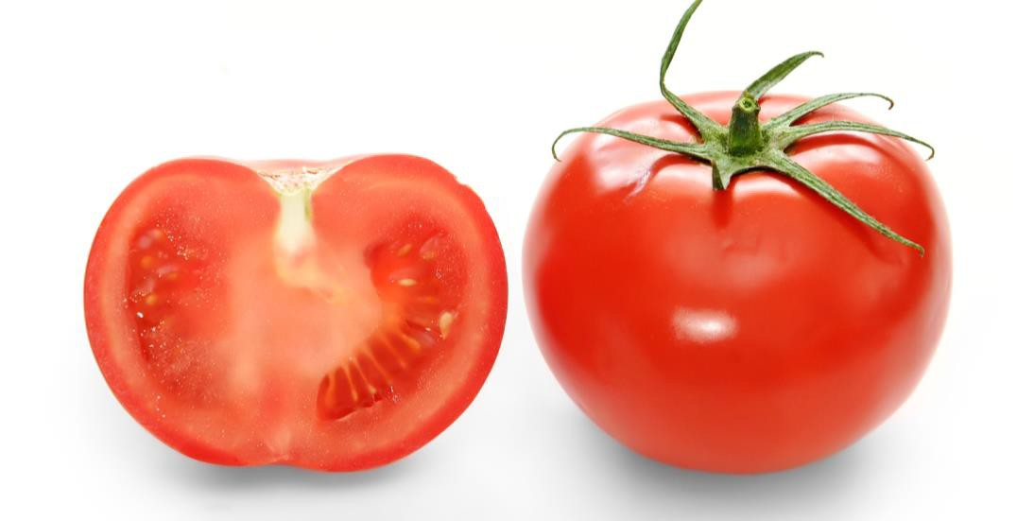
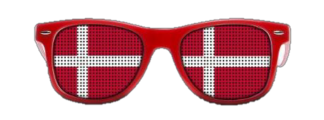
ADVANTAGES
HARVEST ANYWHERE/ANYTIME: horticulturist and rise your season crops all the year, harvest foreign vegs and fruits.
Growth tomatoes in Denmark?
17 Pedro.cifuentes@sysled.es

Slide 18
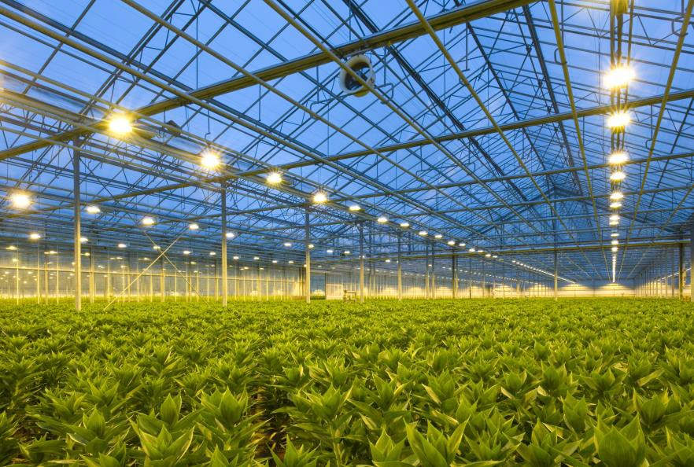
ADVANTAGES
HARVEST ANYWHERE/ANYTIME
IMPROVE PRODUTION, COST REDUCTION: Increase your yields production up to
27% (6), reduce water and power consumption
(6) Nighttime Supplemental LED Inter-lighting Improves Growth and Yield of Single-Truss Tomatoes, 2016, https://www.ncbi.nlm.nih.gov/pmc/articles/PMC4823311/

Slide 19
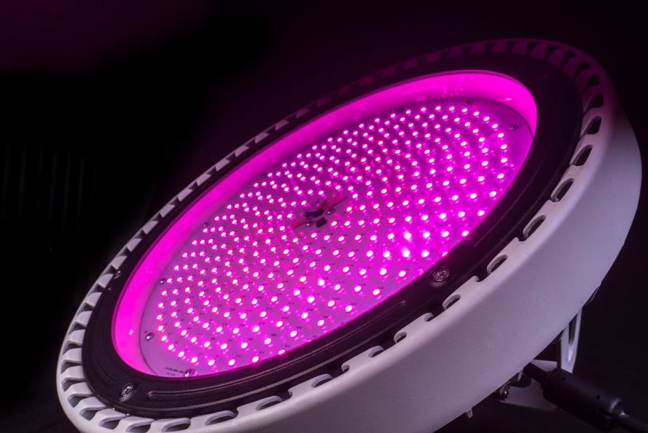
ADVANTAGES
HARVEST ANYWHERE/ANYTIME
IMPROVE PRODUTION, COST REDUCTION
HEALTHIER CROPS: Reduce pesting and fungus impact with UV light, keeping
away chemical products from the food.(7)
(7) UV-C light and pulsed light as alternatives to chemical and biological elicitors for stimulating plant natural defenses against fungal diseases, 2018, https://www.sciencedirect.com/science/article/pii/S030442381830141

Slide 20
ADVANTAGES
HARVEST ANYWHERE/ANYTIME
IMPROVE PRODUTION, COST REDUCTION
HEALTHIER CROPS
LOWER CO2 FOOTPRINT:
Rise crops closer to the consumers
reducing the CO2 footprint.
HIGH RELIABILITY: LED spectrum does not
change along the lifespam of the fixture,
making studies and bigdata more accurate
than HPS
20 Pedro.cifuentes@sysled.es

Slide 21
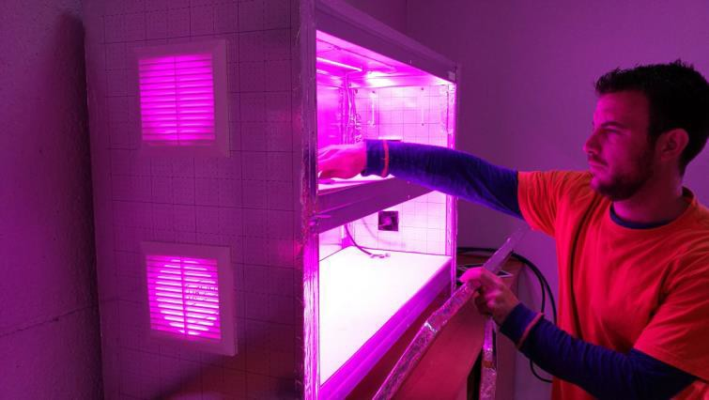
ADVANTAGES
HARVEST ANYWHERE/ANYTIME
IMPROVE PRODUTION, COST REDUCTION
HEALTHIER CROPS
LOWER CO2 FOOTPRINT
HIGH RELIABILITY
INCREASE CROPS QUALITY: LED tomatoes crops have a better taste and LED strawberries have more antioxidants(8), making them the best option for organic greenhouses.
(8) LED and exogenous aminoacids application to imprevo growth and yield of strawberry https://www.sciencedirect.com/science/article/pii/S0304423818303674

Slide 22
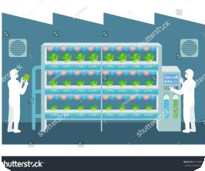
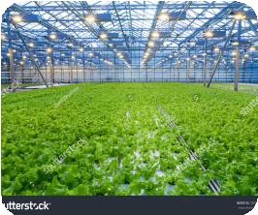
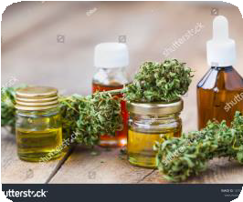
APPLIANCES AND PRODUCTS
R&D centers, Institutes, Indoor farming
Requires accurated spectrum products
Need custom products, Price is secondary
High penetration of lighting innovations
Greenhouses
Requires industrial and reliable products
Demand best performace products, not highest output
Low penetration of lighting innovations
Medical Cannabis
Demand highest lighting requirements, not performance
Top turnover market
Market tied to HID lamps since 60s

Slide 23
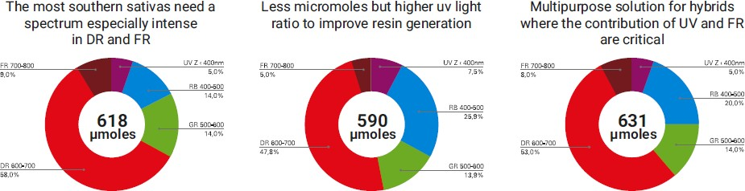
APPLIANCES AND PRODUCTS – NOT ONLY MICROMOLES
SATIVA
PREDOMINANCE
Sour diesel Jack Herer Amnesia
INDICA PREDOMINANCE
Northern Lights Blueberry Compolti
HYBRIDS
OG Kush Pineapple Express Carmagnola
ALSO AVAILABLE FOR SUPPLEMENTARY LIGHTING:
Vegetative supplement
Flowering supplement
- Germination supplement
23 Pedro.cifuentes@sysled.es

Slide 24
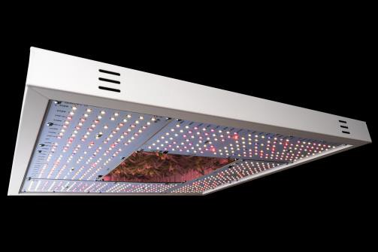
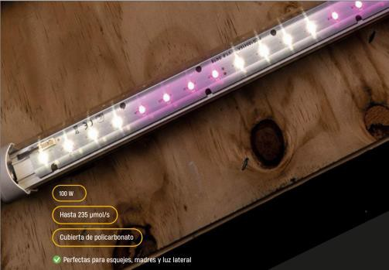
APPLIANCES AND PRODUCTS
Heisenberg 300-450-600W
  60x60cm OR 85x85cm
  Custom spectrum for tomato, medical cannabis
  Best option for indoor farming
  Fanless and full spectrum with 330 LEDs
Faraday kit 2x60, 2x120, 5x120, 2x180
  Easy and flexible in 60/120/180cm wired modules
  Slim, best option for shelves/vertical installations
  Germination spectrum also available
24 Pedro.cifuentes@sysled.es

Slide 25
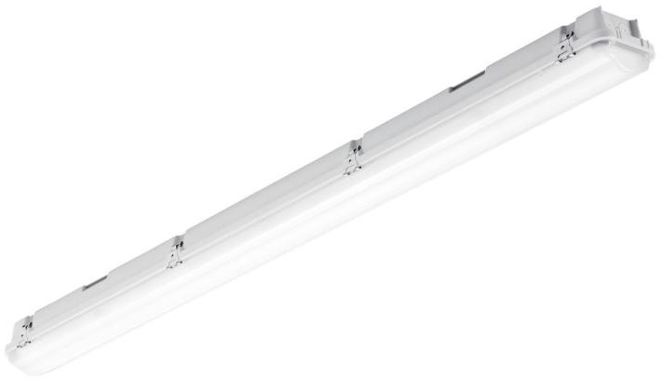
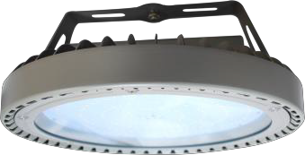
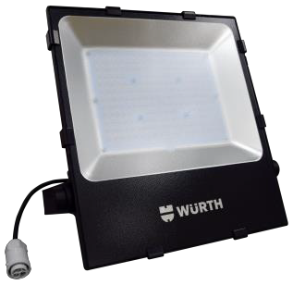
APPLIANCES AND PRODUCTS – OUTDOOR IP65 IK08
Curie 50-100-150 W
  60/120cm/180cm sept19!
  PC housing + PMMA cover for harrash envirorments
  VEG-FLO-HYB spectrums available
Highbay 240 W
  Roof installation
  Aluminium diecasting
  Best replacement for 400W HPS in greenhouses
Floodlight 240W
  Wall installation – Optics available
  Aluminium diecasting
  Best replacement for 400W HPS in greenhouses

Slide 26
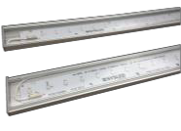




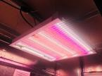




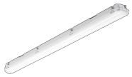

APPLIANCES
Photo | Product | Watts | Institutes Vertical Farming | Greenhouses | Medical Cannabis | SPECTRUM
 | FARADAY | 25/50 100 150 |  |  |  | VEG, FLOW, GER
 | HEISENBERG | 300 450 600 |  |  |  | DARWIN, HEISENBERG
 | CURIE | 50 100 150 |  |  |  | VEG, FLOW, GER, HYB
 | Highbay | 240 |  |  |  | HYB
 | Floodlight | 240 |  |  |  | HYB

Slide 27
EXPERIENCES
10 years of experience LED Lighting
• +6 million LEDs assembled on 2018
• +2500sqm of indoor cannabis in 2018
• +1000sqm of Algae chlorea in 2018
Projects in Spain, France, Belgium, South Africa, Iceland, Japan, Italy and counting
1200sqm facilities in Madrid
100% developed and assembled in Spain
27 Pedro.cifuentes@sysled.es

Slide 28
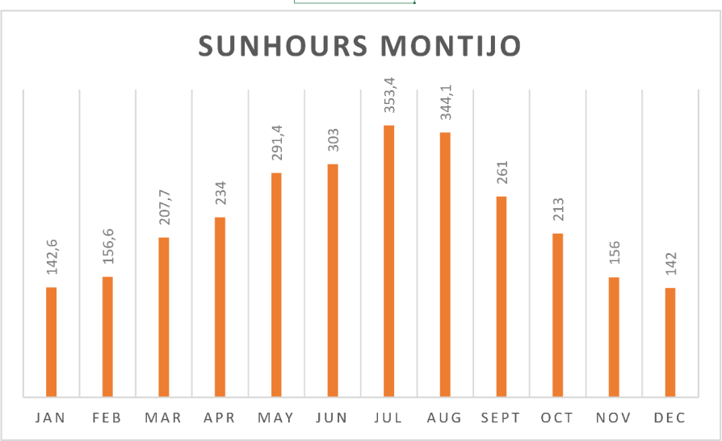
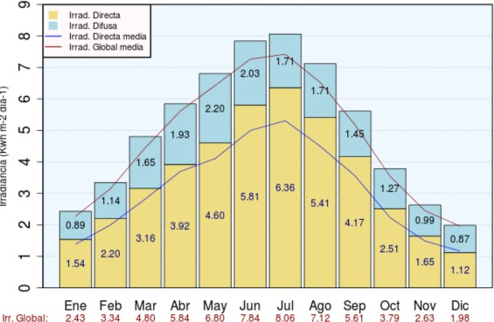
ABOUT MONTIJO SAMPLE – Day Light Integral
Sun hours x2 on summer months as well as irradiance
Note that irradiance values are from Badajoz (150km away)
Wikipedia https://en.wikipedia.org/wiki/List_of_cities_by_sunshine_duration#cite_note-121
AEMET report http://www.aemet.es/documentos/es/serviciosclimaticos/datosclimatologicos/atlas_radiacion_solar/atlas_de_radiacion_24042012.pdf

Slide 29
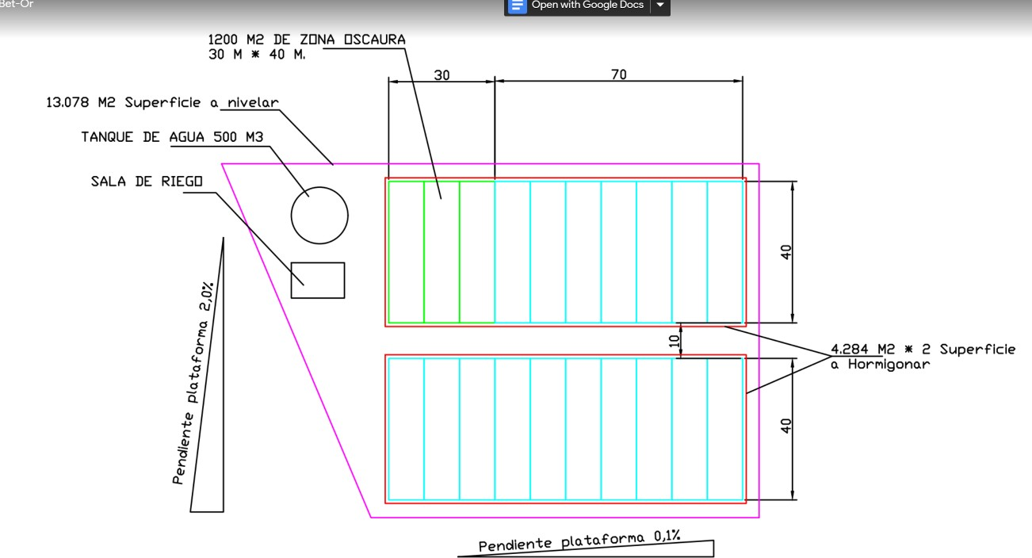
ABOUT MONTIJO SAMPLE - GREENHOUSE
x2 4000sqm greenhouses for cloning-seeding
Natural light + LED supplement
29 Pedro.cifuentes@sysled.es

Slide 30
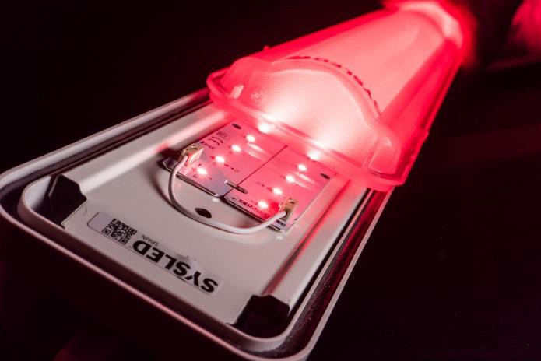
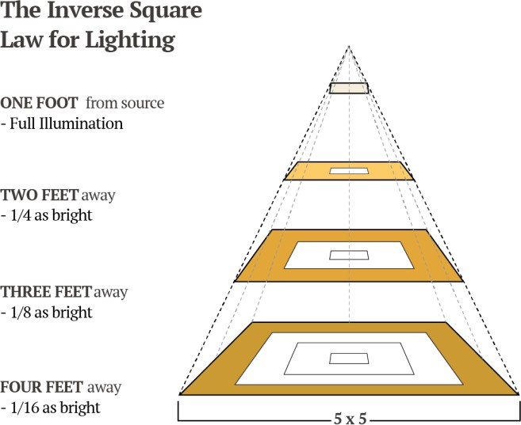
Which appliance fits better here?
CURIE 120cm FIXTURE
  Reliable IK08 & waterproof IP65
  Cover big surface
  €/W efficient
  Homogeneous light over the canopy
  Reduce wiring
30 Pedro.cifuentes@sysled.es

Slide 31
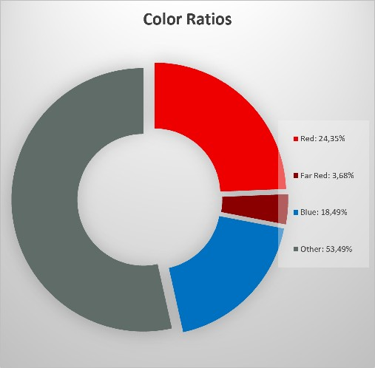
ABOUT MONTIJO SAMPLE - SPECTRUM
SYSLED BIO VEG SPECTRUM supply the perfect ratios of radiation for
boosting radicular system of clones/seeds as well as rising a dense and healthy canopy. Can be used as supplement or as single lighting source
31 Pedro.cifuentes@sysled.es

Slide 32
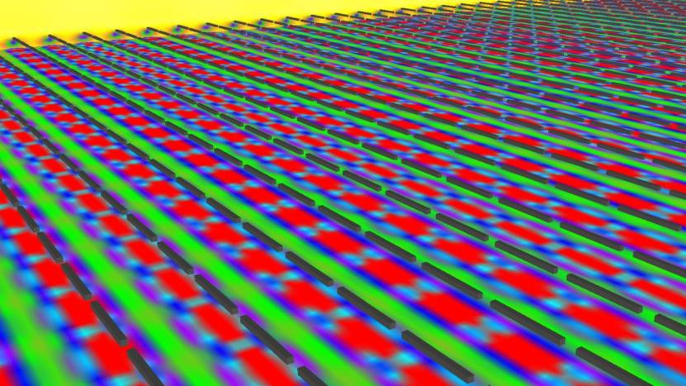
ABOUT MONTIJO SAMPLE – FIXTURE DISTRIBUTION
Assuming a SOG with horizontal travelling we have filled the greenhouse
Assuming lamps installed 40-50cm from canopy
Assuming interdistance of 1.5m H/V for each fixture center
66x26 luminaires

Slide 33
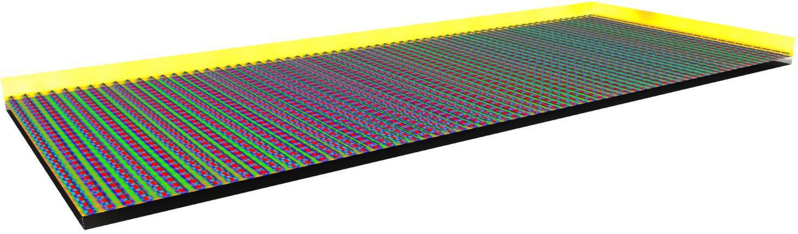
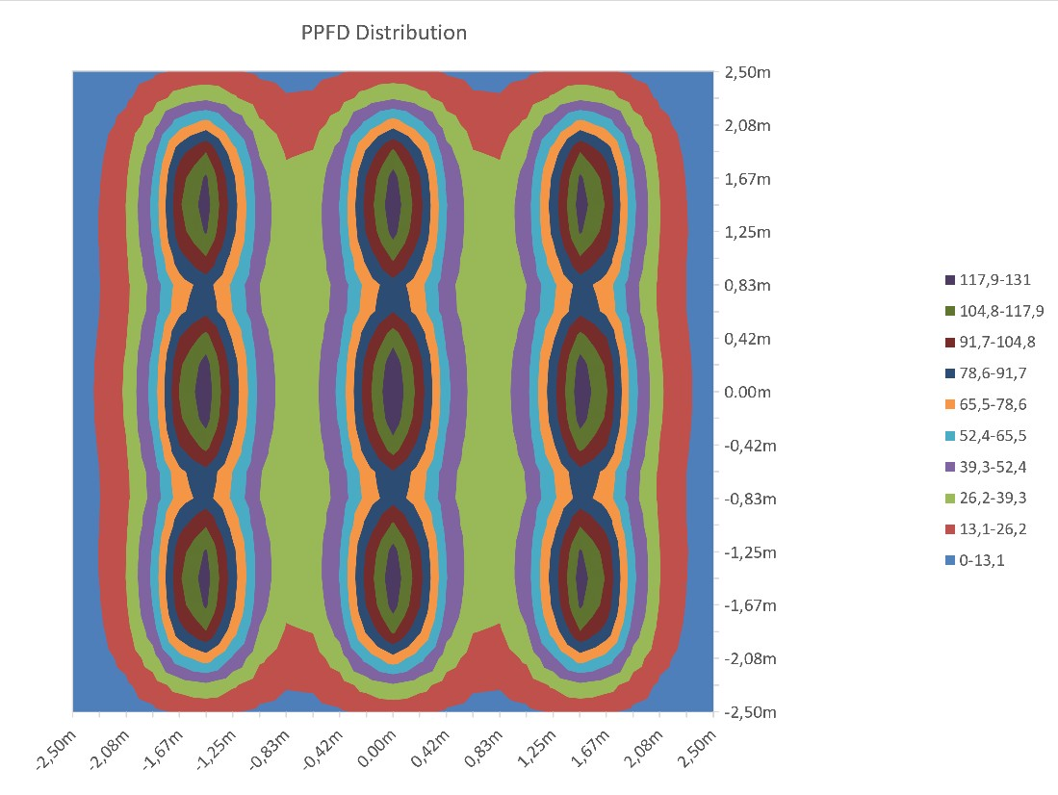
ABOUT MONTIJO SAMPLE – LIGHT DISTRIBUTION
33 Pedro.cifuentes@sysled.es

Slide 34
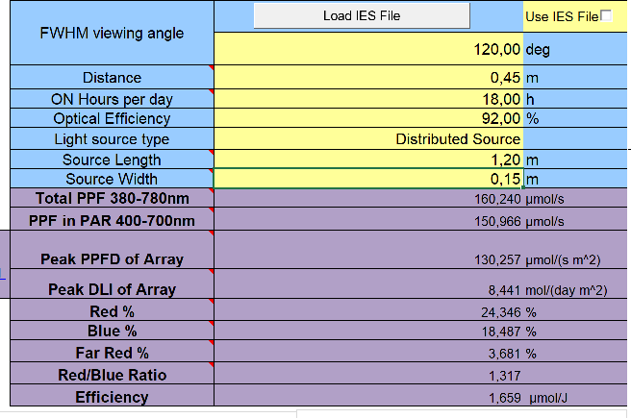
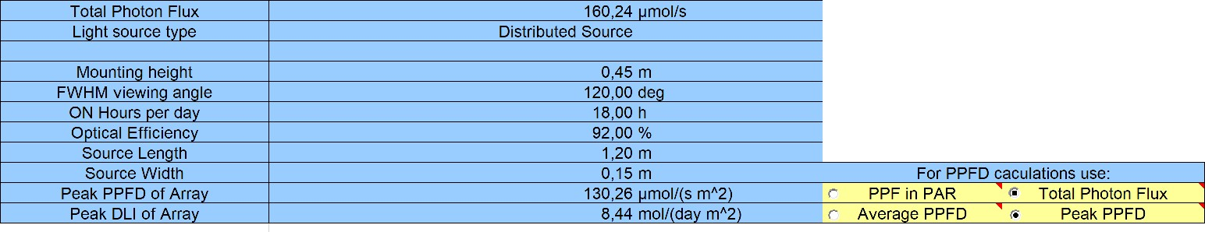
ABOUT MONTIJO SAMPLE – PERFORMANCE
34 Pedro.cifuentes@sysled.es

Slide 35
ABOUT MONTIJO – OPTIONS
OPTION A – CURIE 120cm 100W VEG
  11000 lm/lamp
  40-150 umoles/sqm
  4k-8k luxes/sqm
  42.9 W/m irradiance
  170kWh / greenhouse
  High output and low price
35 Pedro.cifuentes@sysled.es

Slide 36
ABOUT MONTIJO SAMPLE – OPTIONS
OPTION B – CURIE 120cm 50W VEG
  6000 lm/lamp
  20-72 umoles/sqm
  2k-4k luxes/sqm
  21 W/m irradiance
  85kWh / greenhouse
  Lower monthly expenses

Slide 37
ABOUT MONTIJO SAMPLE – OPTIONS
OPTION C – CURIE 120cm 100W VEG DIMMABLE
  Up to 11000 lm/lamp
  Up to 150 umoles/sqm
  Up to 8k luxes/sqm
  Up to 42 W/m irradiance
  Up to 170kWh / greenhouse
  Control by solar beacon or programmer
  Top saving lamps

Slide 38
ABOUT MONTIJO – CONCLUSIONS
 | OPTION A | OPTION B | OPTION C
POWER (W) | 100 | 50 | 100
DIMMABLE | NO | NO | YES
LUMENS | 11000 | 6000 | Up to 11000
MICROMOLS | 40-150 | 20-72 | Up to 40
LUX/SQM | 4000-8000 | 2000-4000 | Up to 8000
IRRADIANCE(W/m) | 42 | 21 | Up to 42
TOTAL kWh/gh | 170 | 86 | <170

Slide 39
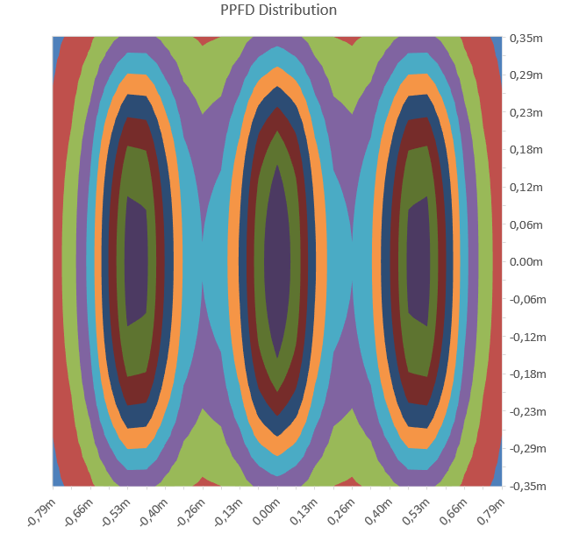
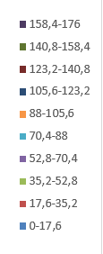
SIMULATION 1 - x3 Slim Profiles 60cm @20cm 0,5m interdistance 75W / shelve
81,31 micromoles/s m2
5,27 mol/day m2
Coefficiente of variation 461%

Slide 40
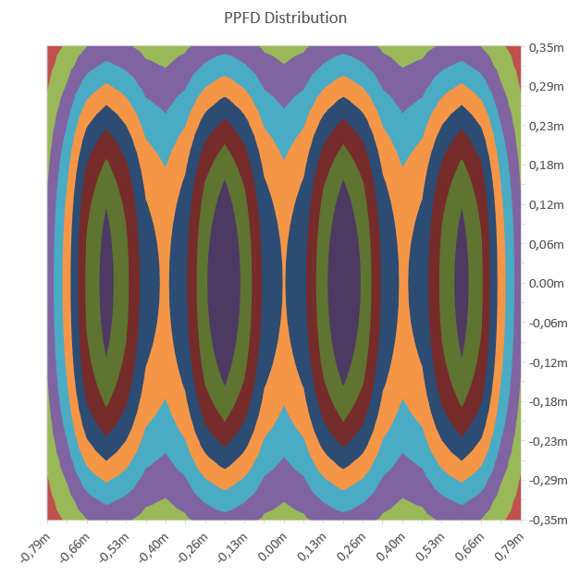
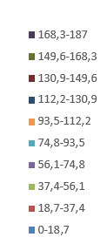
SIMULATION 2 x4 Slim Profiles 60cm @20cm 0,4m interdistance 100W / shelve
106,22 micromoles/s m2
6,88 mol/day m2
Coefficiente of variation 378%

Slide 41
Simulation 20W each 60cm profile PROFILES INSTALLED WIDTH
Output is closer to requested light density
3 profiles per shelve is enough along the surface but density is poor on the corners, indirect light can fill this gap
4 profiles per shelve achieves best uniformity

Slide 42
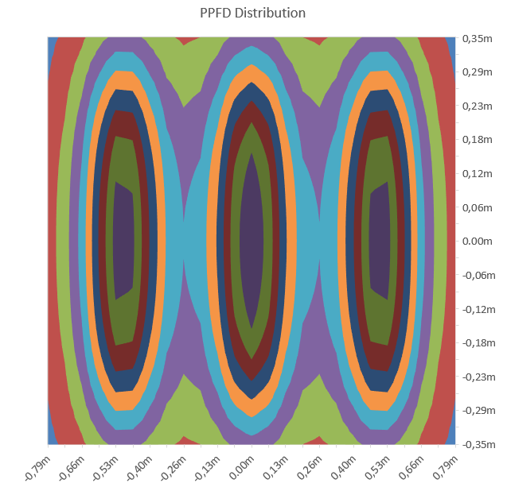
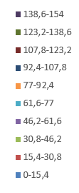
SIMULATION 3 x3 Slim Profiles 60cm @20cm 0,5m interdistance 60W / shelve
71,17 micromoles/s m2
4,61 mol/day m2
Coefficiente of variation 431%

Slide 43
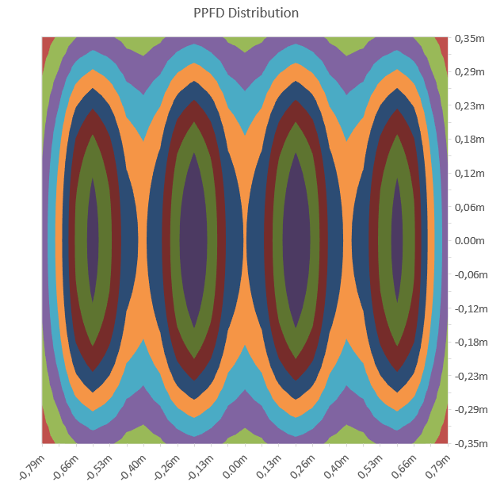

SIMULATION 4 x4 Slim Profiles 60cm @20cm 0,4m interdistance 80W / shelve
92,97 micromoles/s m2
6,02 mol/day m2
Coefficiente of variation 354%

Slide 44
Simulation 40W each 120cm profile PROFILES INSTALLED LONG
Output is closer to requested light density
2 profiles per shelve is enough along the surface but density is poor on the corners, indirect light can fill this gap
Profiles are 120cm so they dont fit propertly on this sizing

Slide 45


SIMULATION 5 x2 Slim Profiles 120cm @20cm 0,4m interdistance 80W / shelve
92,98,17 micromoles/s m2
6,03 mol/day m2
Coefficiente of variation 451%

Slide 46
Conclusions
Best performance comes with simulation 4
2 profiles per shelve is enough along the surface but density is poor on the corners, indirect light can fill this gap (simulation 5) but it´s the cheapest option
Higher lumen output also comes with worst coefficience of variation
Simulations have applied Tj=50º and 7% of optical losses

